Slide 1
Fundamentals of CRE
Chemical Reaction Engineering
By
Dr Salah N. Farhan
Senior lecturer. Chem. Eng. Dept.
College of Engineering
University of Diyala
Salah N. Farhan College of Engineering Diyala University

Slide 2
Fundamentals of CRE
Chapter 10: Non Isothermal Reactor
Salah N. Farhan College of Engineering Diyala University

Slide 4
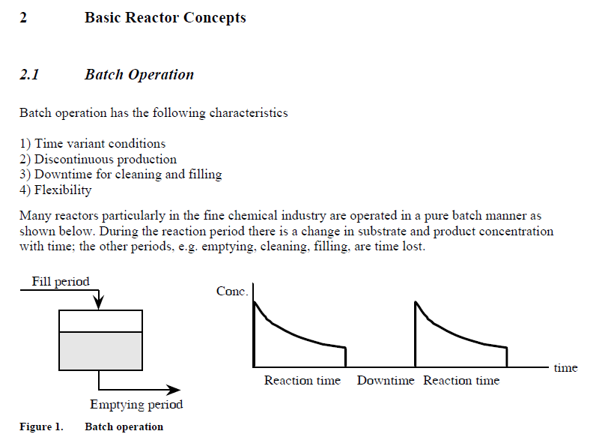

Slide 5
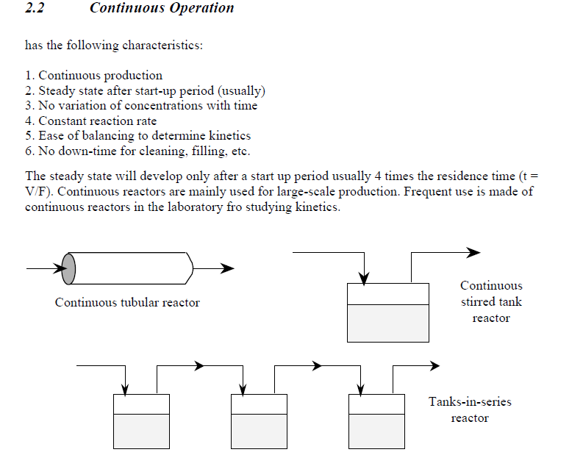

Slide 6
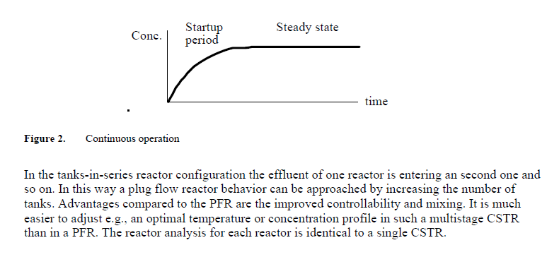

Slide 7
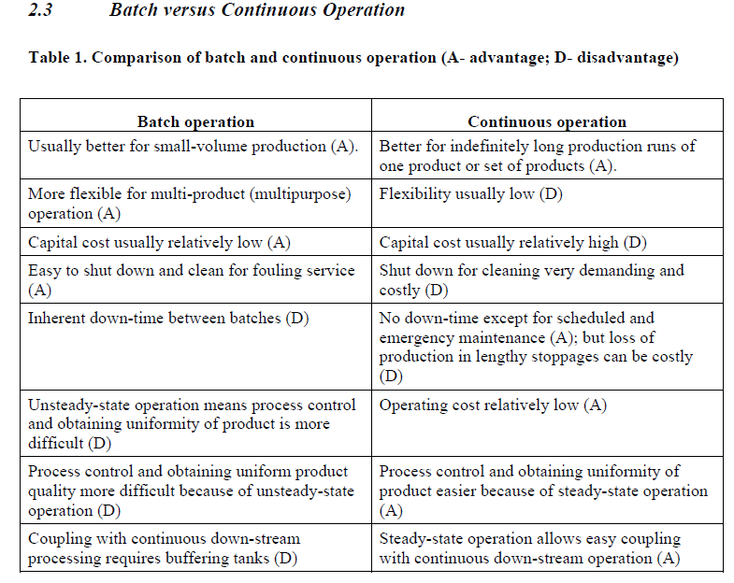

Slide 8
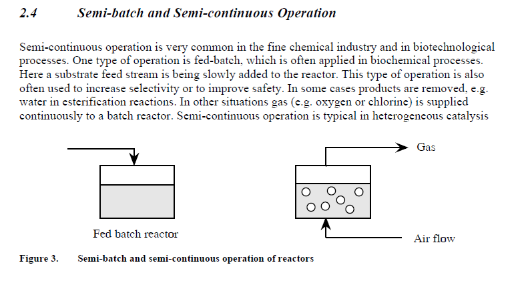

Slide 9
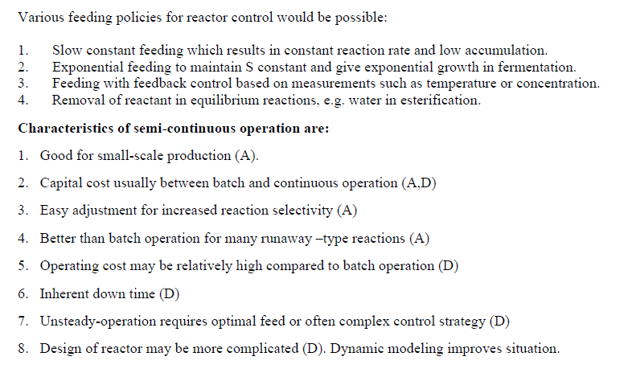

Slide 10
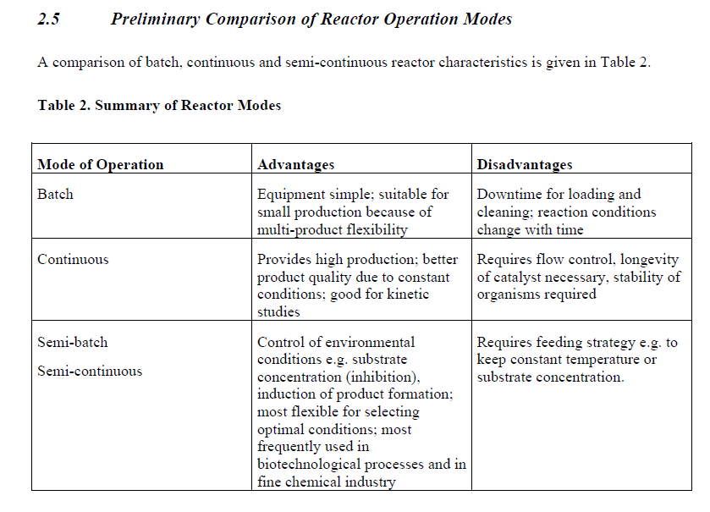

Slide 12
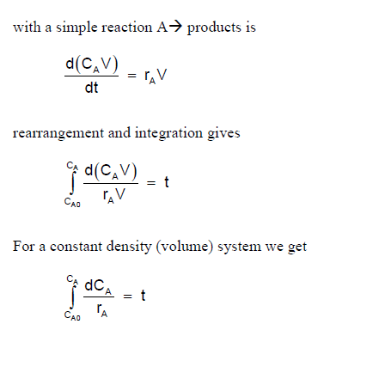

Slide 13
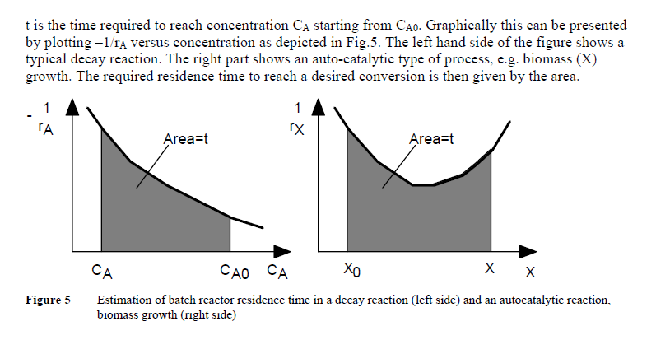

Slide 14
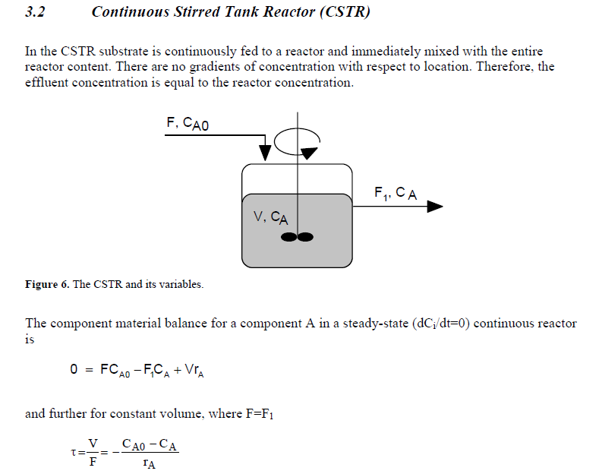

Slide 15
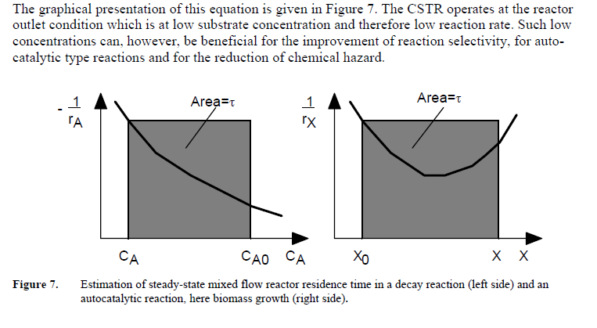

Slide 16
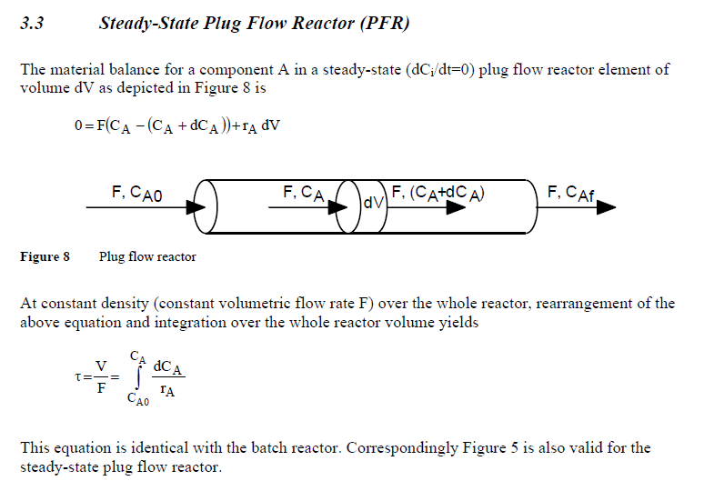

Slide 17
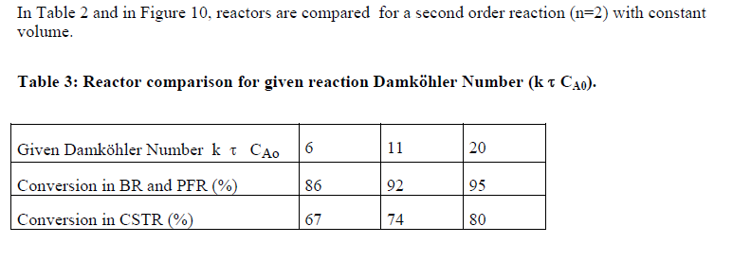

Slide 18
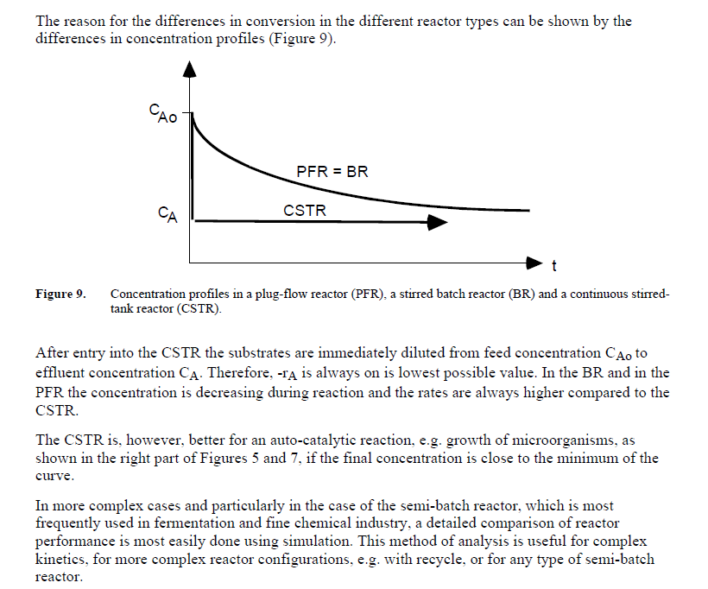

Slide 20
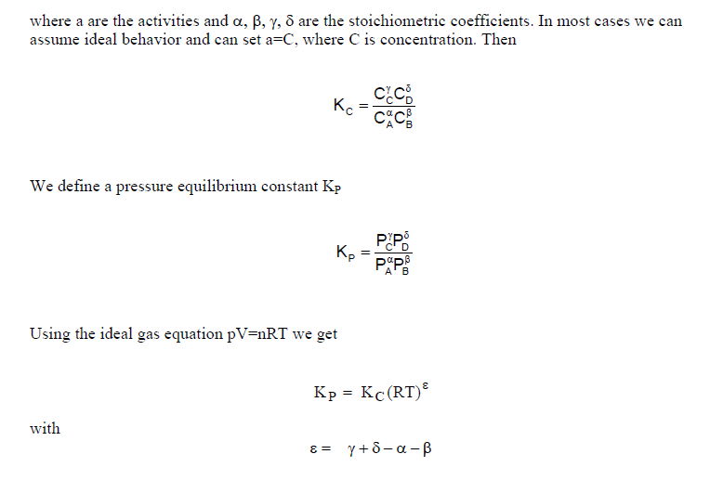

Slide 21
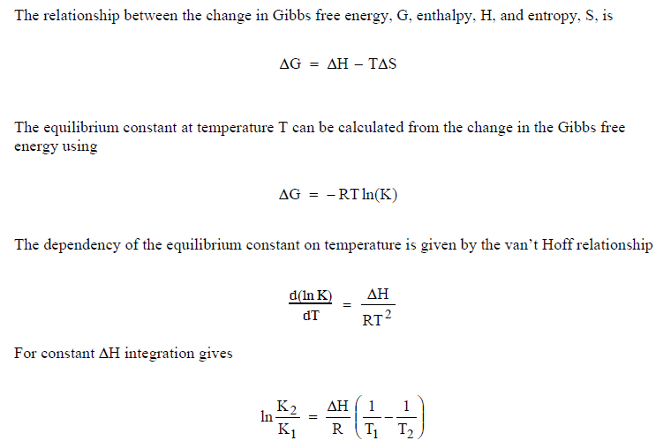

Slide 22
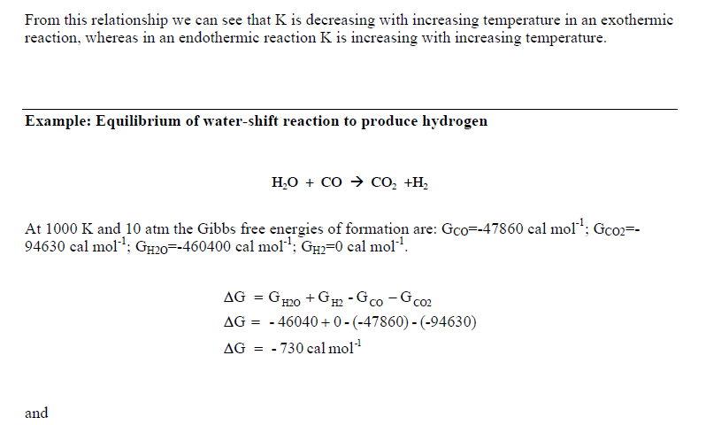

Slide 23
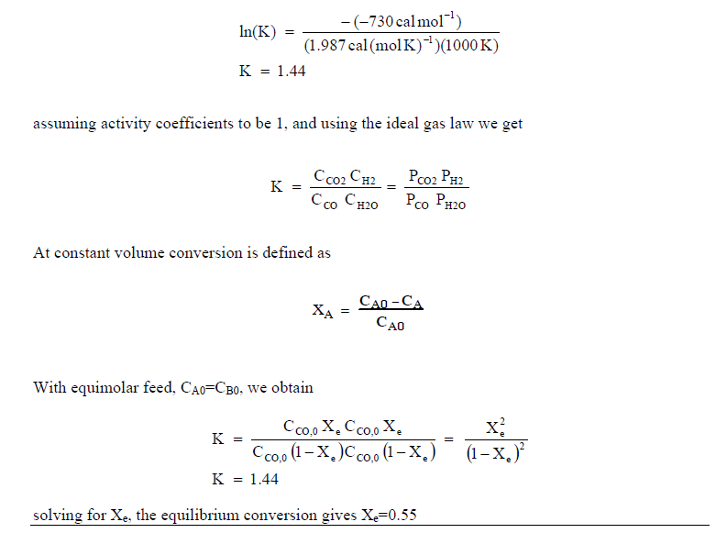

Slide 24
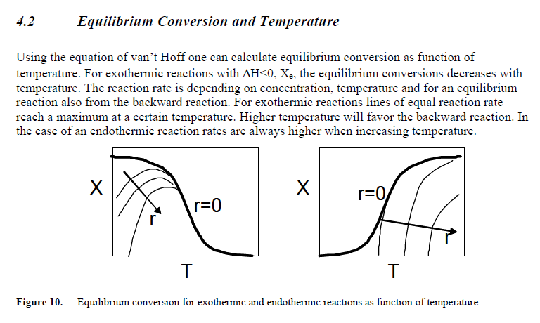

Slide 25
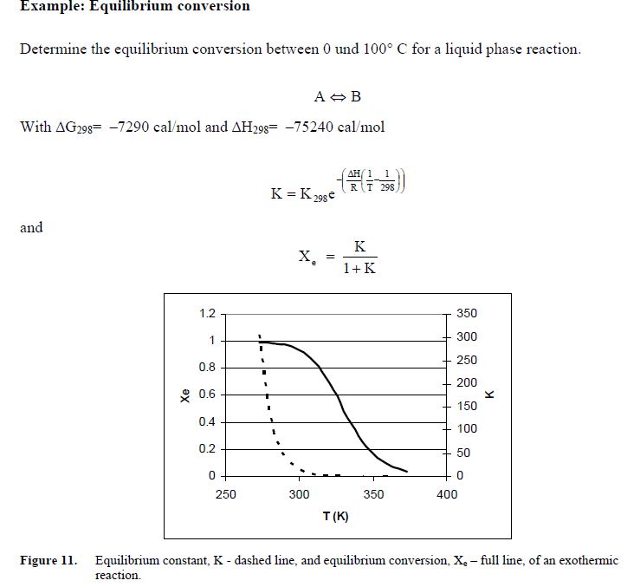

Slide 26
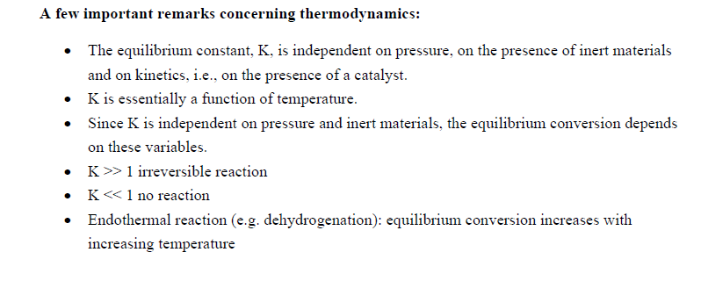

Slide 27
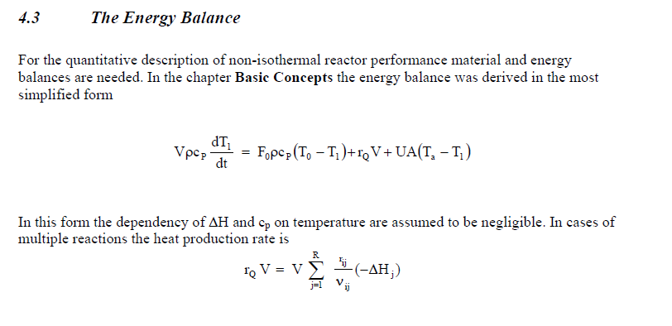

Slide 28
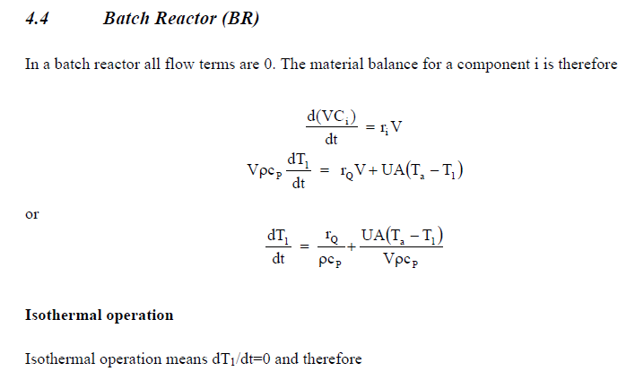

Slide 29
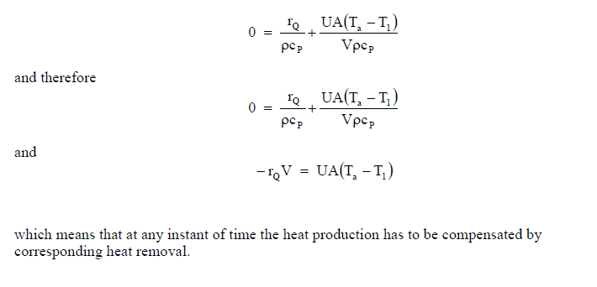

Slide 30
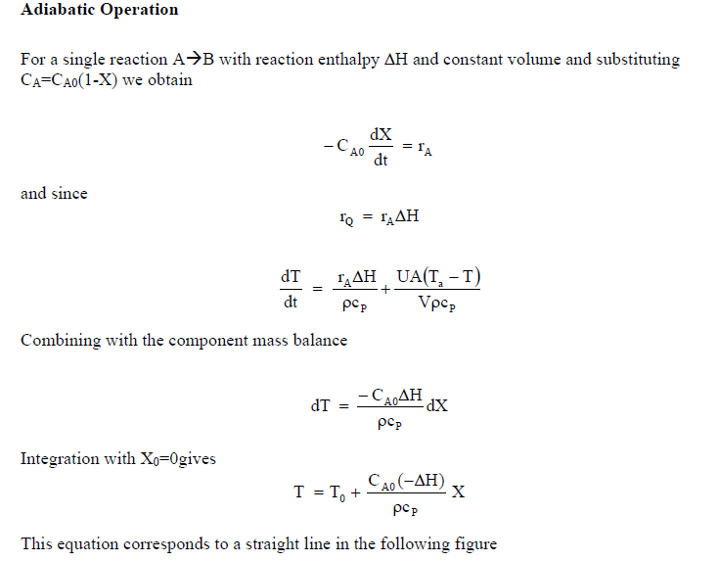

Slide 31
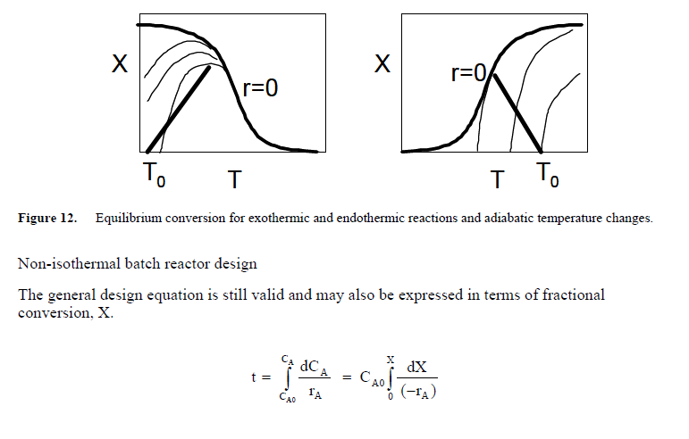

Slide 32
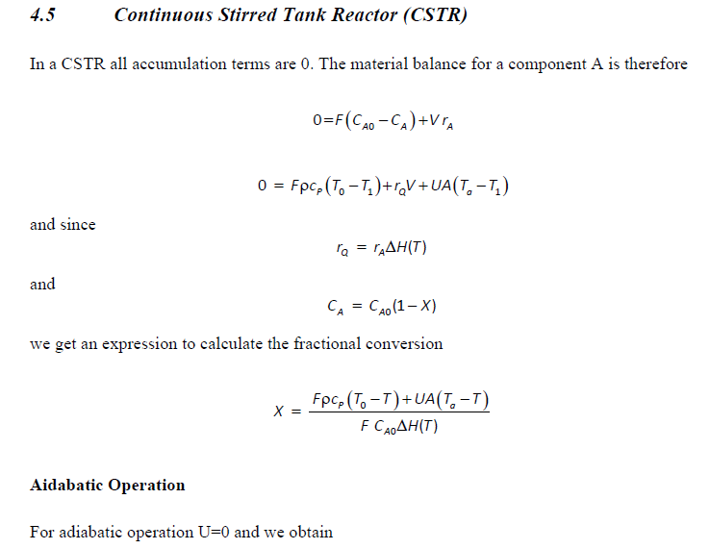
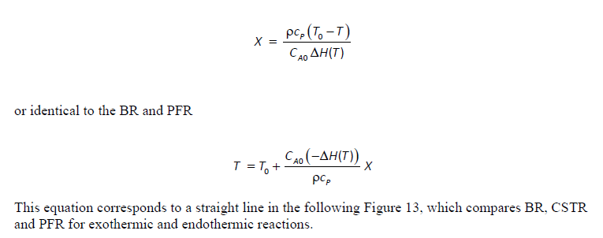

Slide 33
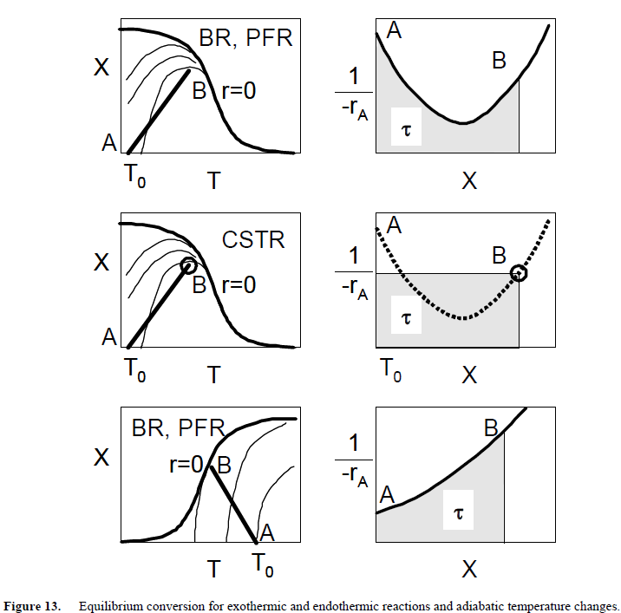
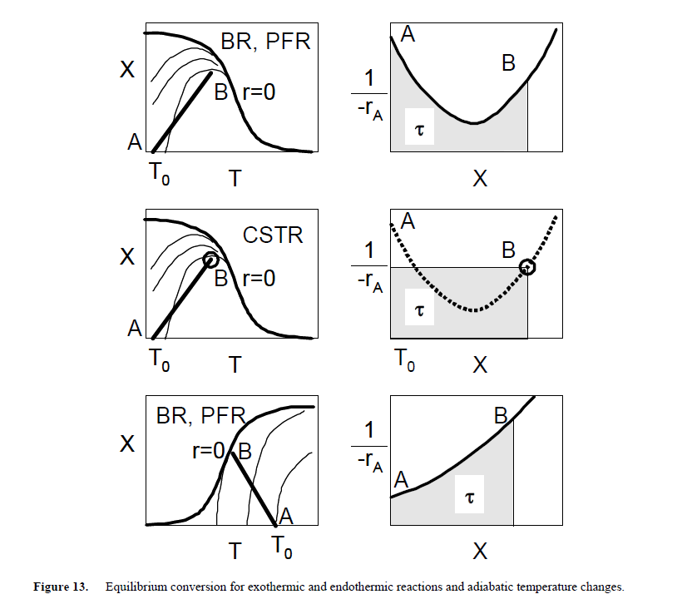

Slide 34
للشكل اعلاه في حالة التوازن لتفاعل باعث للحرارة ,كلما زادت الحرارة فان سير التفاعلExtent of reaction تقل لذك عند درجة واطئة فان Extent عالية وبالعكس.
وعند اجراء التفاعل في حالة isothermal فان النقطة الموضحة في الشكل اعلاه,نحصل على 0.7 تقريبا.
لكن عند اجراء العمل في ظروف Adiabatic فانه لا توجد اضافة او سحب للحرارة ولدينا تفاعل باعث للحرارة
فان هناك ميل لارتفاع درجة الحرارة لذلك تقل Extent لحدود 0.4 على الخط الموضح في الرسم اعلاه.
لذلك يجب ان يجرى التفاعل باسرع وقت وايضا القلق من ان يحدث تفاعل عكسي.
لذلك في تفاعلات الحرارة الثابتةIsothermal نحصل على تحول عالي باقل درجة حرارة وهذا يعني معدل تفاعل اقل.

Slide 35
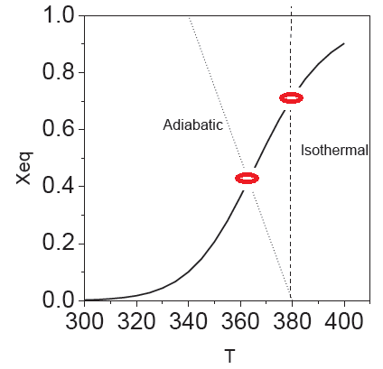

Slide 36
Topics to be covered in this Module
Module 6a (Sections 8.2, 8.3, 8.4, 8.6.1 – Fogler, 4th Edition)
Develop Energy Balance equations for flow reactors.
Enthalpy, Heat Capacity, and Heat of Reaction and relationship between them
Heat transfer rates for CSTR and PFR/PBR
Algorithms for Non-isothermal CSTR and PFR
Module 6b (Sections 8.5 and 8.7)
Equilibrium Conversion (Reversible Reactions) in Reactors
Conversion attainable during adiabatic operation of endothermic and exothermic reactors
Increasing Conversion by inter-stage cooling and heating

Slide 37
Why Do We Need Energy Balance ?
Every reaction proceeds with release or absorption of heat.
The amount of heat released or absorbed depends on
the nature of reacting system
the amount of material reacting
temperature and pressure of reacting system
and can be calculated from heat of reaction (ΔH_{Rxn})
Most industrial reactors will require heat input or heat removal, hence, we need energy balance.

Slide 38
Energy Balance for Single Reaction
An exothermic reaction is carried out in an adiabatic plug flow reactor.
How would you calculate the reactor volume required to achieve a certain amount of conversion, X ?
We need to relate X and T ----> Energy Balance Equation

Slide 39
User-Friendly Design Equations

Slide 40
User-Friendly Design Equations
We would like to understand how these design equations were developed

Slide 41
General Form of Energy Balance
Rate of flow of heat to the system from the surrounding
Rate of work done by the system on the surroundings
Rate of energy added to the system by mass flow into the system
Rate of energy leaving the system by mass flow out of the system
Rate of accumulation of the energy within the system
–
+
–
=
Control Volume

Slide 42
General Form of Energy Balance (for multi component system)
Next, we will evaluate the “W” and “E” terms

Slide 43
Understanding Work and Energy Terms in the EB equation

Slide 44
Evaluation of the Work (W) term
In a chemically reacting systems, there are usually two types of work that need to be accounted for – (i) Shaft Work (e.g. work done by impellers in a CSTR and batch reactor) and (ii) Flow Work
Rate of flow work is rate of work to get mass into and out of the system

Slide 45
Evaluation of the E term
Energy E_{i} is the sum of internal, kinetic, potential and any other type of energies.
For a majority of reactors, only internal energy is important

Slide 46
General Form of Energy Balance (for multi component system)

Slide 47
Energy Balance Equation in terms of Enthalpy
Substituting appropriate values of E_{i} and Rate of Work
Now,
We now have, Energy Balance Equation in terms of Enthalpy
Next, we will focus on the enthalpy terms

Slide 48
Here’s what we’ll do with Enthalpy terms
Express H_{i} in terms of Enthalpy of Formation (H_{i}º ) and Heat Capacity (Cp_{i})
Express F_{i} in terms of conversion (for single reaction) or rates of reaction
Define Heat of Reaction (ΔH_{Rxn)}
Define Δ Cp

Slide 49
Enthalpy Relationships: Single Reaction System
T₀
T
If A is the limiting reactant
F_{i} in terms of F_{A0} and X
from stoichiometry

Slide 50
Enthalpy Relationships: Single Reaction System
ΔH_{Rxn}
Next, we will evaluate the different terms of RHS

Slide 51
Expressing H_{i}(T) in terms of H_{i}º and Cp_{i}
Enthalpy at any given temperature is related to enthalpy at a reference temperature and heat capacity
For no phase change
H_{i} is available from Chemical Engg handbook
Therefore,
And,

Slide 52
Heat of Reaction (ΔH_{Rxn})
Heat of reaction is defined as:
Enthalpy at any given temperature is:
where,

Slide 53
General Form of Energy Balance
Energy Balance Equation in terms of Enthalpy
Energy Balance Equation in terms of Conversion

Slide 54
Heat Transfer (Q) to/from Reactors

Slide 55
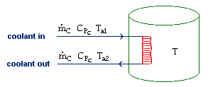
Heat Transfer (Q) to a CSTR
Heat transferred between coolant and reactor
(from energy balance on the coolant)
Assuming CSTR temperature,T, is spatially uniform
For high coolant flow rates (T_{a1} ≅ T_{a2}=T_{a}):

Slide 56
Heat Transfer (Q) to a PFR
Remember, in PFR/PBR the concentration and reaction rates vary along the reactor length. Q will likely vary too.
Total heat transferred to the reactor
T_{a}
T
a = heat exchange area/volume
Heat transfer rate at a given location in a PFR

Slide 57
Non-Isothermal Reactors

Slide 58
Non-isothermal Flow Reactor
Application-1 Special Case: Adiabatic Reactor with No Shaft Work
Applying Q = 0 and W_{s}=0 in the above equation, we get
X_{EB}
If Cp term<<ΔH_{Rxn}
T

Slide 59
Non-isothermal Flow Reactor
Application-2: CSTR with Heat Exchange; no shaft work
Applying W_{s}=0 in the above equation, we get
Let us see if we can apply these concepts to solve a CSTR problem.

Slide 60
Class Problem #6
The following liquid-phase reaction is carried out in a CSTR with heat exchange:
The feed stream contains A and B in equimolar ratio. The total molar flow rate is 20 mol/s. The inlet temperature is 325 K, the inlet concentration of A is 1.5 molar, and the ambient temperature in the heat exchanger is 300 K.
Calculate the reactor volume necessary to achieve 80% conversion.
Additional information
U= 80 J/m² s K
A=2 m²
ΔH_{Rxn}(298) = -10,000 J/mol
Cp_{A} = Cp_{B}= 100 J/mol K
Cp_{C} = 150 J/mol K
E=25,000 J/mol
k₂₉₈ = 0.014 L/mol-s

Slide 61
Non-isothermal Flow Reactor
Application-3: PFR with Heat Exchange
F_{A0}
T₀
F_{Ae}
T_{e}
T
V
V+ΔV
Differentiating the Energy Balance equation with respect to V, we get

Slide 62
Non-isothermal Flow Reactor
Application-3: PFR with Heat Exchange (cont.)
Let us evaluate the differential terms of the EB equation
The first term on LHS can be written as
T_{a}
T
V
V+ΔV
a = specific surface area for heat transfer = area/volume
U = overall heat transfer coefficient
Ta = Temperature of heat transfer fluid (outside of the reactor)

Slide 63
Non-isothermal Flow Reactor
Application-3: PFR with Heat Exchange (cont.)
Let us evaluate the differential terms of the EB equation
The derivative in the third term on LHS can be written as
Recall, that for a reaction: aA + bB → cC + dD, the reaction rates are related by the stoichiometric coefficients

Slide 64
Non-isothermal Flow Reactor
Application-3: PFR with Heat Exchange (cont.)
Let us evaluate the differential terms of the EB equation
The derivative in the fifth term on LHS can be written as
The fifth term on LHS can be written as

Slide 65
Non-isothermal Flow Reactor
Application-3: PFR with Heat Exchange (cont.)
Substituting, the derivative terms into the Energy Balance Equation we get
Rearranging the above equation in terms of dT/dV, we get

Slide 66
Non-isothermal Flow Reactor
Application-3: PFR with Heat Exchange (cont.)
How do we solve non-isothermal PFR problems?
or
We MUST solve the two differential equations, g(X,T) and f(X,T),
simultaneously.
We will need Ordinary Differential Equation (ODE) solver -- MATLAB

Slide 67
Other forms of EB equation for PFRs
For single reaction systems
You may note that for exothermic reaction, this term will result in an increase in T
For single reaction systems in term of conversion

Slide 68
Class Problem #7
It is proposed to design pilot plant for the production of Allyl Chloride. The feed stream comprises 4 moles propylene/mole chlorine. The reactor will be vertical tube of 2 inch ID. The combined feed molar flow rate is 0.6 g-mol/h. The inlet pressure is 2 atmospheres. The feed stream temperature is 275 C. Calculate Allyl Chloride production as a function of tube length for the following 2 cases:
Case-1: PFR jacketed with heat exchange fluid circulated at 275 C Case-2: Adiabatic operation of PFR

Slide 69
Class Problem #7 (cont.)
MAIN REACTION: Cl₂ + C₃H₆ → CH₂=CH-CH₂Cl + HCl
SIDE REACTION: Cl₂ + C₃H₆ → CH₂Cl-CHCl-CH₃
T is in Kelvin and p is in atm
U = 28 W/m²-K
-ΔH_{Rxn1}(298)=110,000 J/mol
-ΔH_{Rxn2}(298)=181,500 J/mol

Slide 70
Fundamentals of CRE
Salah N. Farhan College of Engineering Diyala University

Slide 71
Fundamentals of CRE
Salah N. Farhan College of Engineering Diyala University

Slide 72
Fundamentals of CRE
Salah N. Farhan College of Engineering Diyala University

Slide 73
Fundamentals of CRE
Salah N. Farhan College of Engineering Diyala University

Slide 74
Fundamentals of CRE
Salah N. Farhan College of Engineering Diyala University

Slide 75
Fundamentals of CRE
Salah N. Farhan College of Engineering Diyala University

Slide 76
Fundamentals of CRE
Salah N. Farhan College of Engineering Diyala University

Slide 77
Fundamentals of CRE
Salah N. Farhan College of Engineering Diyala University

Slide 78
Fundamentals of CRE
Salah N. Farhan College of Engineering Diyala University

Slide 79
Fundamentals of CRE
Salah N. Farhan College of Engineering Diyala University

Slide 80
Fundamentals of CRE
Salah N. Farhan College of Engineering Diyala University

Slide 81
Fundamentals of CRE
Salah N. Farhan College of Engineering Diyala University

